Slide 1







The Power of Charity to Transform Lives
DONATION & CHARITY MANAGEMENT SYSTEM
MYDONATERS

Slide 2
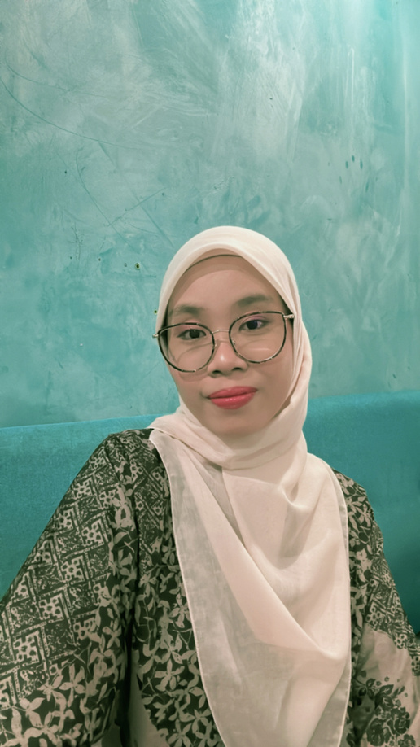
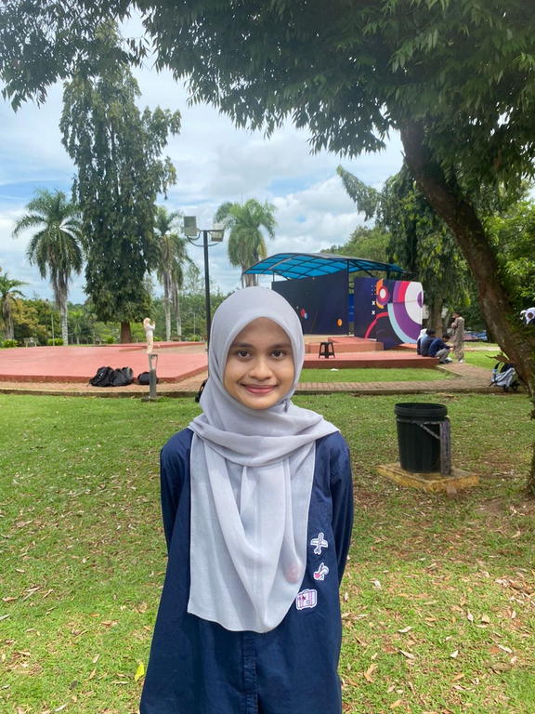
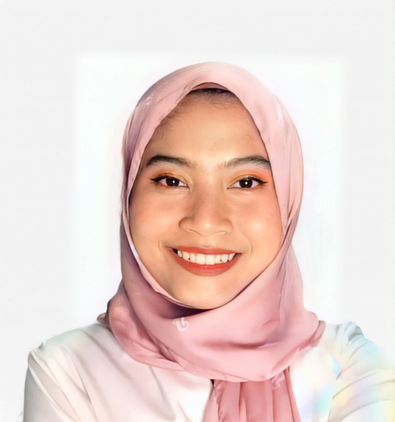

TEAM MEMBERS
Nurul Syahirah binti Sa’dun
Nur Hasni Binti Mohamad Hijazi
Lailatul Aida binti Nazri
Nur Saidatul Aqilah binti Samsuddin

Slide 3

WHAT IS MYDONATTERS?
Mydonnaters is a public donation system that offers a flexible and user-friendly platform for anyone to contribute to those in need. Donors can choose to support specific causes by selecting items such as food, water, clothes and many more. They also can simply contribute by entering a preferred donation amount.
Financial Donation
Goods Contribution

Slide 4


OBJECTIVE
To support admin roles and security
To manage donor and beneficiary records efficiently
To ensure transparency and accountability
To digitize and automate the donation process

Slide 5
PROBLEM STATEMENT?
Lack of transparency in fund distribution
Inefficient communication with donors and volunteers
Increased risk of data errors and fraud
Transparent, traceable system causes mistrust and reduces overall donations.

Slide 6



TYPES OF DONATION
Shoes
Food
Medical Kits
Water
Clothes
Money
Bedsheet

Slide 7
PROJECT SCOPE
ADMIN
Overview of recent donations
Admins can also edit, view and delete member details
Admin has ability to track all donations made by members.
Allows the admin to view important information about each member.
MEMBERS
Ennsuring that they can easily select their desired items to donate
Allows members to review their donation details and proceed with payment securely.

Slide 8


USER
INTERFACE

Slide 9
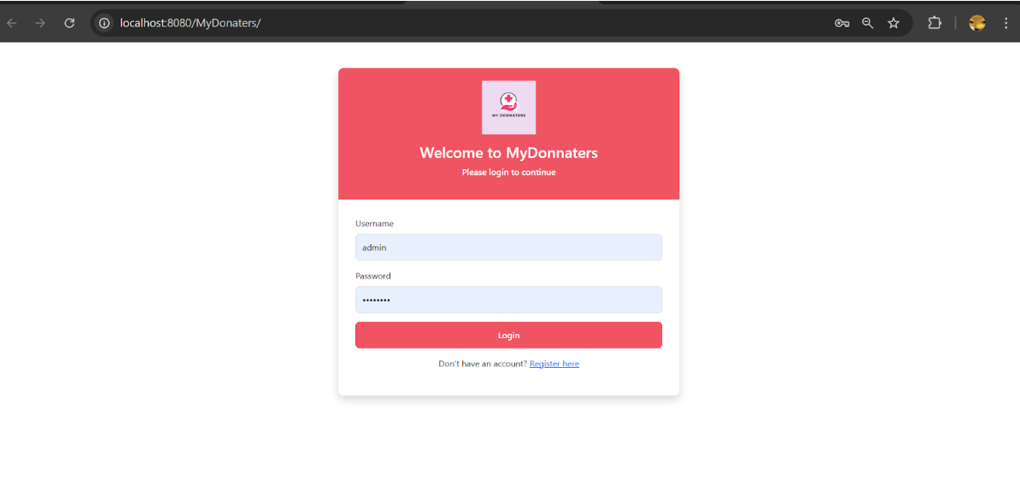
LOGIN

Slide 10
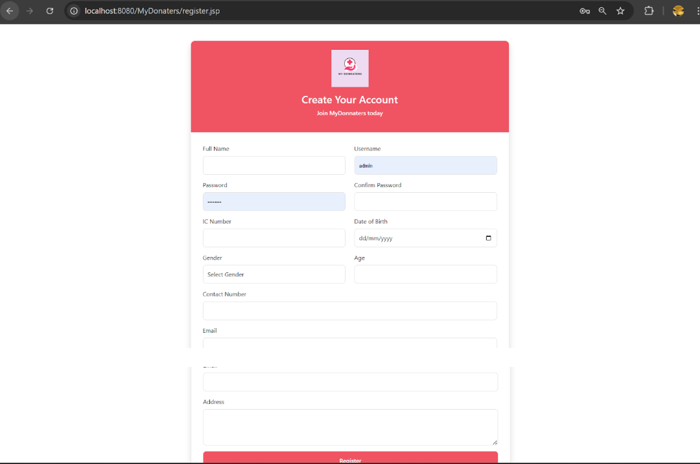
REGISTRATION

Slide 11
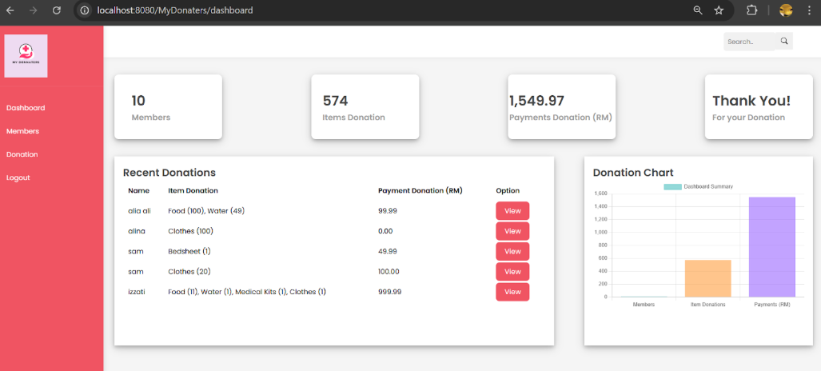
ADMIN SCREEN

Slide 12
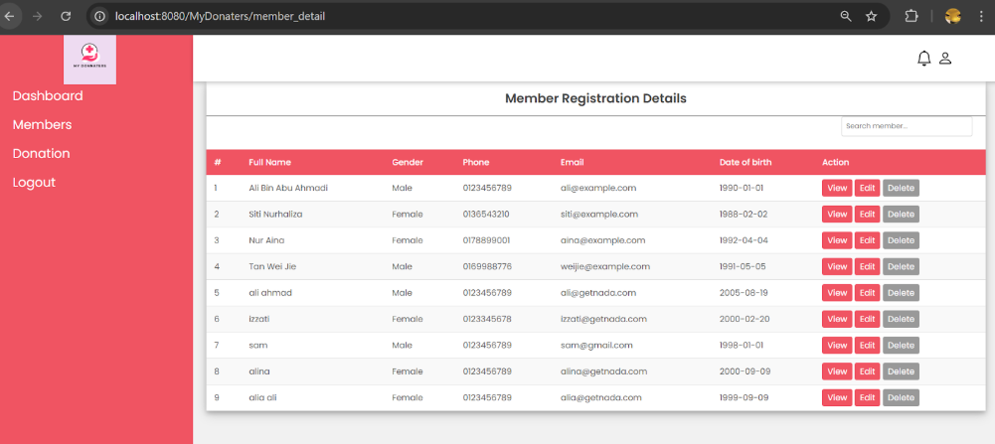
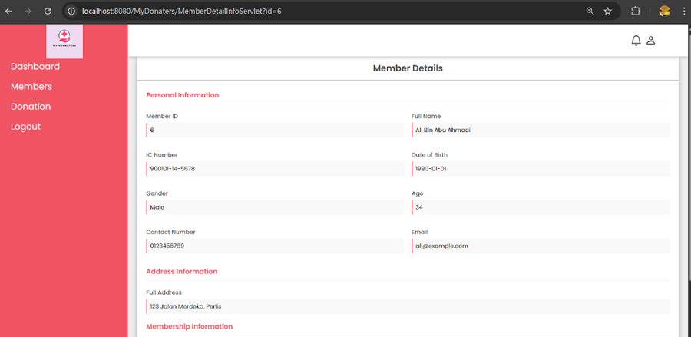
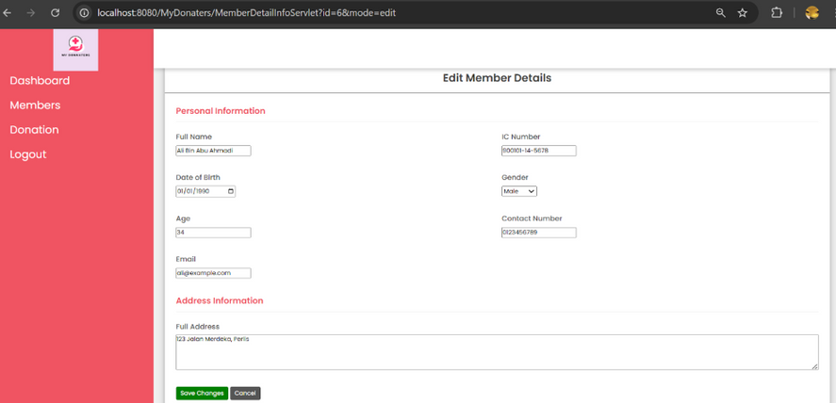
MEMBER DETAIL
VIEW
EDIT
DELETE

Slide 13
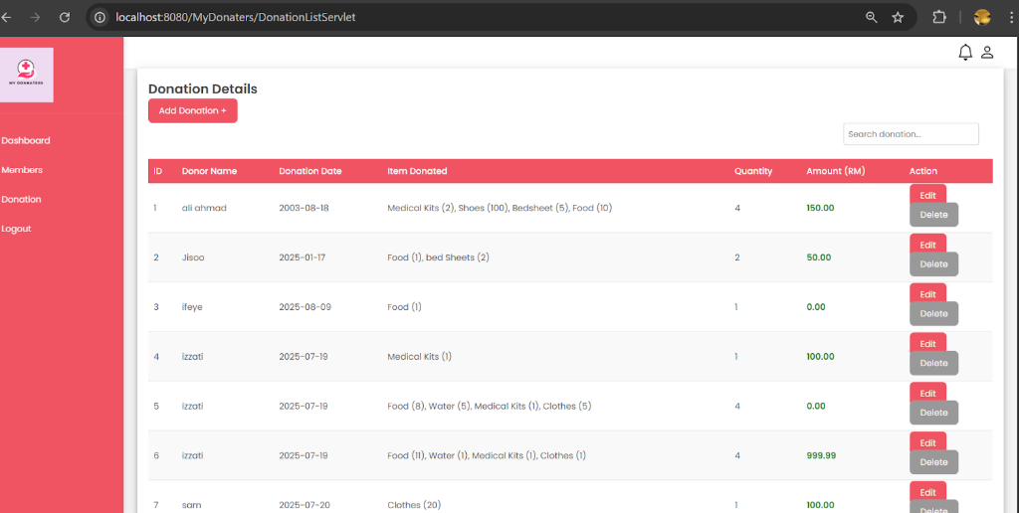
DONATION DETAILS

Slide 14
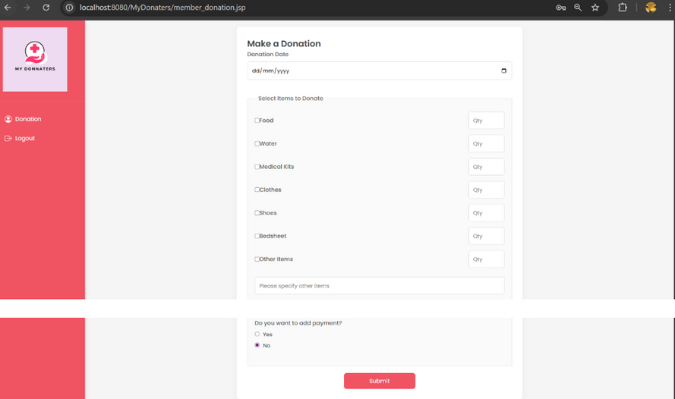
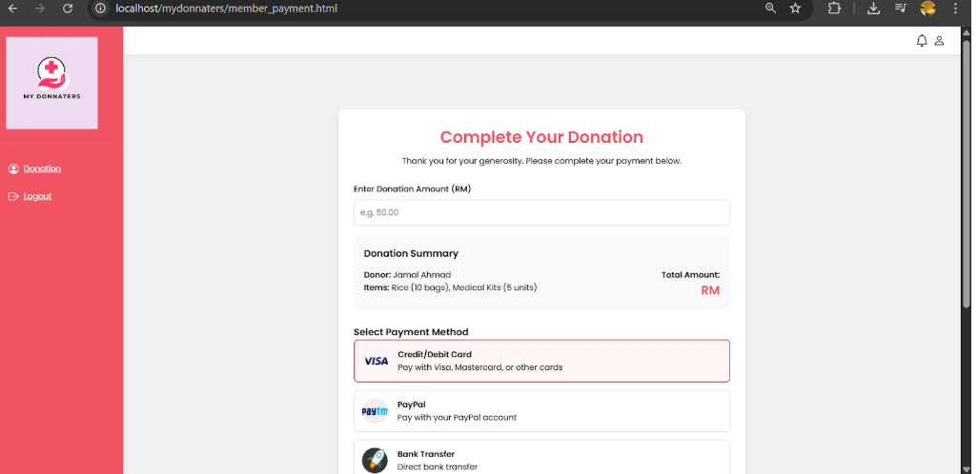
MEMBER SCREEN
GitHub Link

Slide 15
THANK YOU

